Slide 1
Umanga Pandey 2015 October
Self Direction

Slide 2
Your direction, your happiness!

Slide 3
3 recurring steps
Reflect (Internal)
Research (External)
Resources .
Gain entry skills
Develop Skills
Identify interests
Discover aptitude
World Trend
Work on the craft

Slide 4
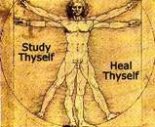
Your interests are your compass

Slide 5
Focus on the feasible

Slide 6
Develop skills that build on your top interests

Slide 7
Freedom that is used well….

Slide 8
…..is the Freedom that lasts!

Slide 9
…to your happiness!

